Slide 1
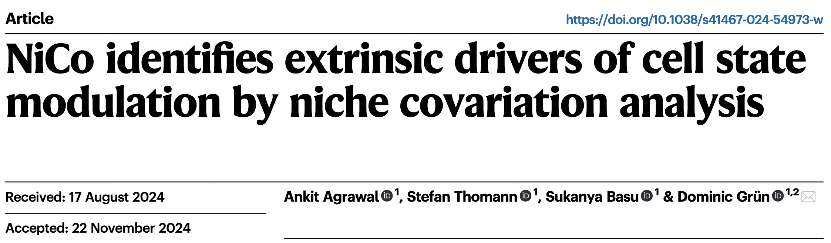
Analysis of cell-cell interactions in tissues using niche covariation (NiCo)
MOPITAS 2025 - Christian Eger & Helene Hemmer- PhD students with Dominic Grün

Slide 2
Analysis of cell-cell interactions in tissues using niche covariation (NiCo)
Enable cell type label transfer from scRNA-seq data to corresponding spatial transcriptomics data
Investigate co-localized cell types in the spatial niche
Correlate gene programs in scRNA-seq data with gene expression in spatial modality
Analyze cell-cell interactions and downstream pathways in the spatial data
Data from Dr. Andy Shing Fung Chan

Slide 3
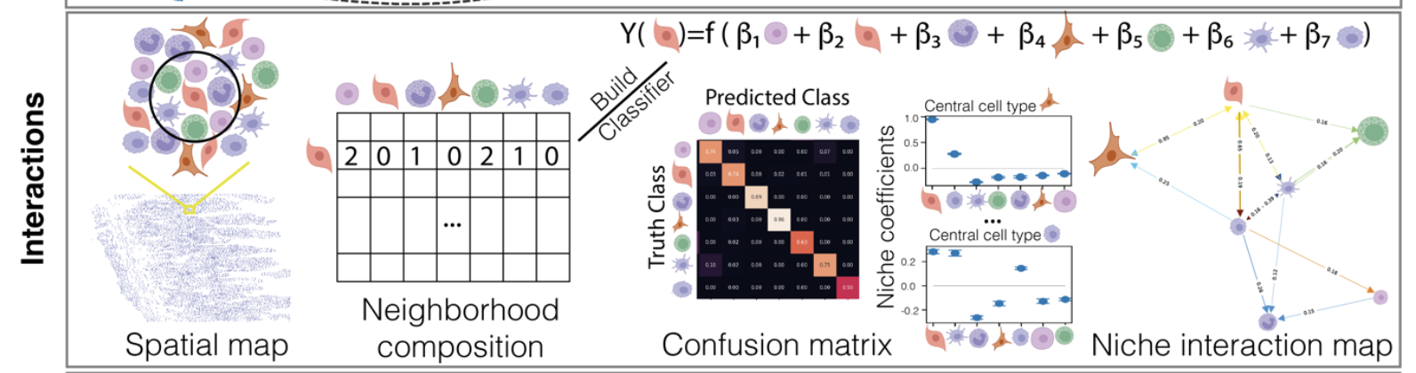
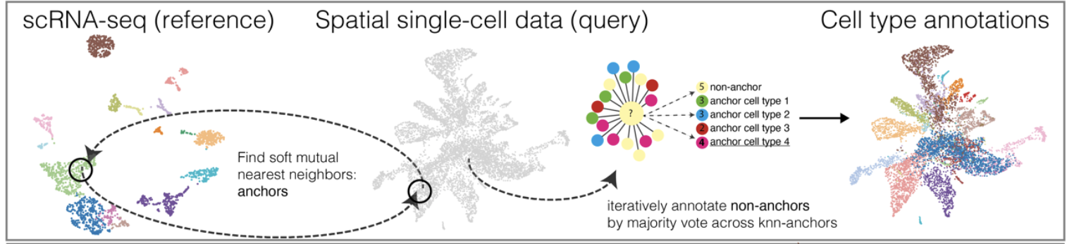
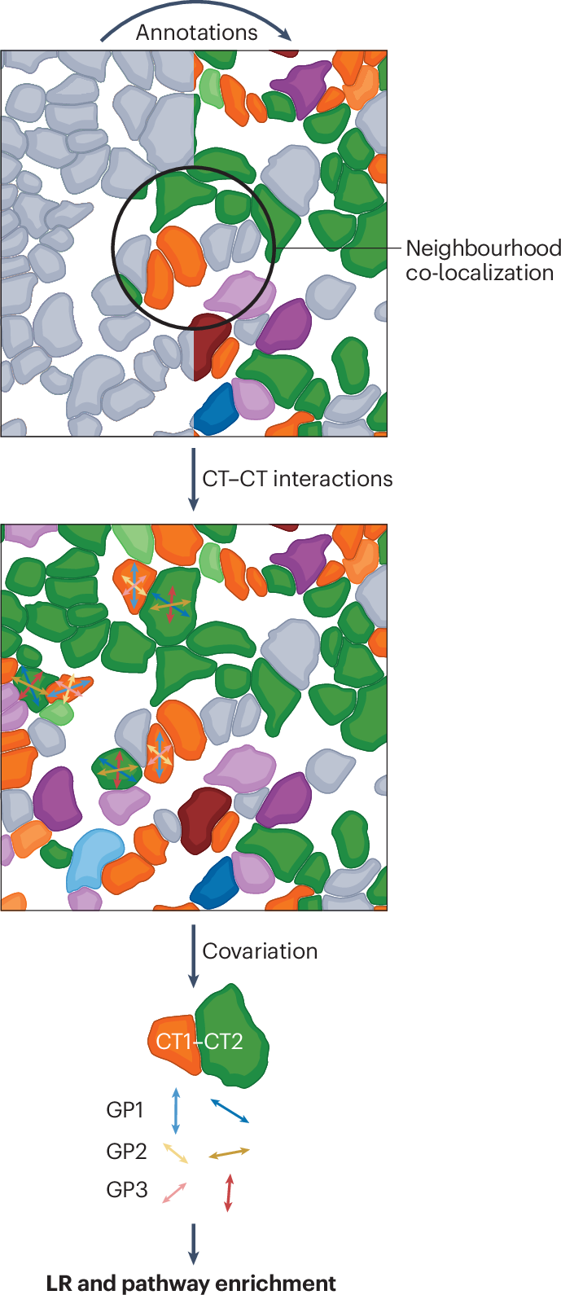
Niche covariation analysis with NiCo
Interaction module
Annotation module
Covariation module

Slide 4
Transfer of cell-type labels from single cell data to spatial data based on mutual nearest neighbors in both modalities
Annotation module
1
A
A
2
Anchor filtering based on Leiden clustering in spatial modality
Interaction module
scRNA-seq reference
A
C
B
C
A
C
C
D
A
A
Mutual nearest neighbors
Transfer labels for anchor cells
B
B
C
B
Covariation module
Non-anchor cell annotation is based on majority vote
3
Spatial query
A
A
A
A
B
A

Slide 5
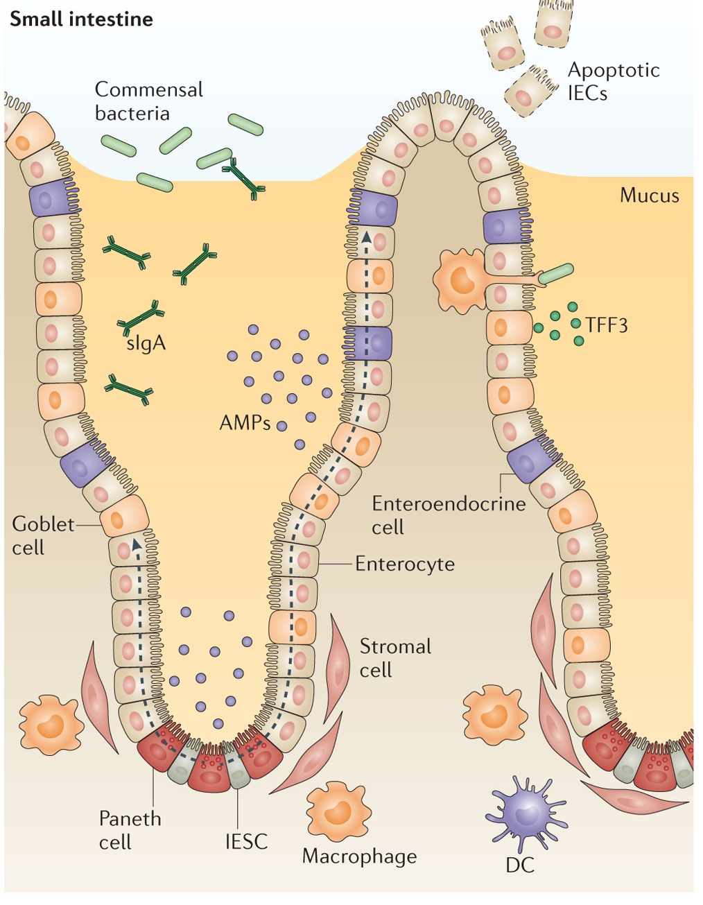
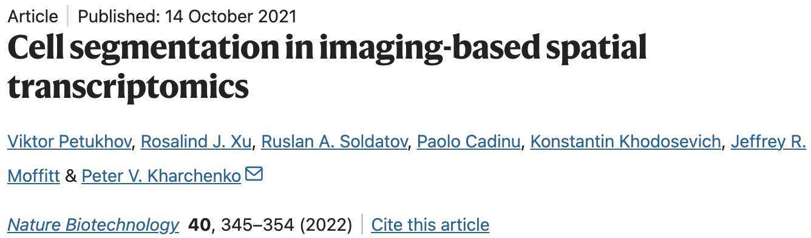
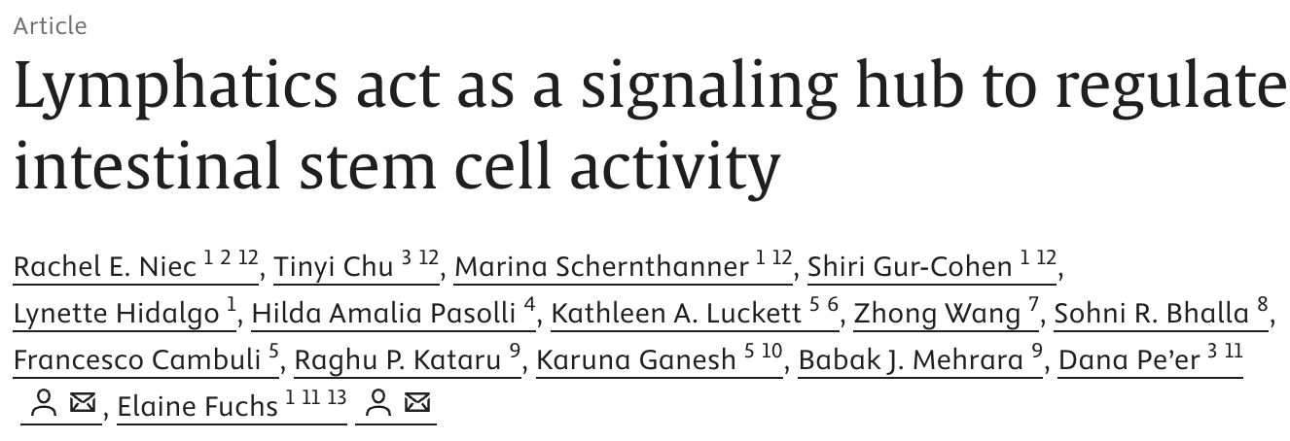
MERFISH data
scRNA-seq data
Peterson, L., Artis, D. Intestinal epithelial cells: regulators of barrier function and immune homeostasis. Nat Rev Immunol 14, 141–153 (2014). https://doi.org/10.1038/nri3608
Notes:
This pattern suggests that the stemness signature covaries with a progenitor signature in neighboring Paneth cells. We note that Paneth cells can emerge directly from stem cells and the nascent Paneth cell progenitors may thus signal to the sister stem cells in order to maintain their stemness

Slide 6
Niche covariation analysis with NiCo
Interaction module
Annotation module
Covariation module

Slide 7
Inference of significant cell-type interactions based on spatial co-localization
Annotation module
Logistic regression classifier
3
Based on neighboring cells, predict the identity of a central cell in the tissue
Neighborhood enrichment matrix
Interaction module
Define neighbors of a cell based on
Delaunay triangulation
1
2
Calculate how many cells of a cell type are in a cell’s neighborhood
A
A
B
Covariation module
A
A
Rationale: If the prediction matches the annotation, the niche interactions are highly relevant for the cell type identity
C
B
Nearest neighbors in the tissue map
Niche composition
Notes:
By default, NiCo uses Delaunay triangulation with a radius 0 as cut-off. This only includes juxtacrine signalling of immediate neighbors
Defining a larger radius includes paracrine signalling
Nico database: CellphoneDB, Natmi and Ominpath
Logistic regression: Compute the probability of a central cell i of being of cell type k given the enrichment ratios of all cell types in the neighborhood of cell i

Slide 8
Niche covariation analysis with NiCo
Interaction module
Annotation module
Covariation module

Slide 9

Niche covariation analysis with NiCo
Interaction module
Annotation module
Covariation module

Slide 10
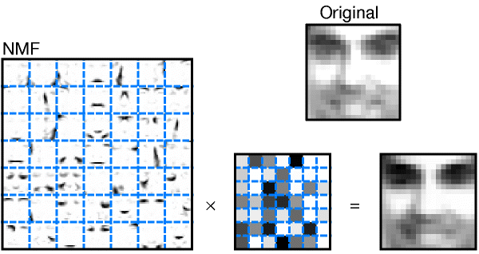
Covariation matrix
Detection of covarying gene expression patterns in co-localized cells for the analysis of cell-cell interactions
1
scRNA-seq reference
~ 21,000 genes
Spatial single cell query
~ 379 genes
2
Computation of gene programs with NMF
Annotation module
Interaction module
Shared gene set
Lee, D., Seung, H. Learning the parts of objects by non-negative matrix factorization. Nature 401, 788–791 (1999). https://doi.org/10.1038/44565
V ≈ W × H
(M × N) ≈ (M × K) × (K × N)
with K: number of factors (i.e., gene programs)
M: number of genes
N: number of cells
W matrix: Which genes define each factor
H matrix: Which factors are active in each cell
Covariation module
iNMF: learns common gene factors between scRNA
seq and spatial modality
oNMF: only use scRNA-seq reference
Notes:
Linear unsupervised dimensionality reduction technique that decomposes your gene expression matrix into two lower-dimensional matrices while maintaining non-negativity
NMF discovers interpretable patterns (factors/programs) that are additively combined to reconstruct the original data.
iNMF:
learns common gene factors W , Hsc factors and Hsp factors from cell type-specific scRNA-seq reference cluster Esc and query spatial cluster Esp after sub-setting to the shared set of genes
optimization incudes penalizing the Frobenius norm
Force gene weights to be the same in scRNA-seq and spatial
oNMF:
matrices Hsc and W are only learned from reference data Esc
aims to optimize the Kullback Leibler divergence
fix these factors for the spatial data while optimizing
By default, NiCo uses 3 factors for the inference of covariance
We recommend 3-5

Slide 11
Covariation matrix
Detection of covarying gene expression patterns in co-localized cells for the analysis of cell-cell interactions
1
scRNA-seq reference
~ 21,000 genes
Spatial single cell query
~ 379 genes
4
Investigate covariation between neighboring
cells for the inference of cellular interactions
Annotation module
GENESET A
Interaction module
Shared gene set
GENESET B
Correlate the gene sets with the full transcriptome using Spearman correlation or cosine similarity
2
Computation of gene programs with NMF
3
21,000 genes
Covariation module
Notes:
regression coefficients: When the neighboring cell type shows high expression of that factor, the central cell tends to also show high expression of its factor → suggests coordinated or synchronized gene programs between the two cell types

Slide 12
MERFISH data
scRNA-seq data
Peterson, L., Artis, D. Intestinal epithelial cells: regulators of barrier function and immune homeostasis. Nat Rev Immunol 14, 141–153 (2014). https://doi.org/10.1038/nri3608
Notes:
This pattern suggests that the stemness signature covaries with a progenitor signature in neighboring Paneth cells. We note that Paneth cells can emerge directly from stem cells and the nascent Paneth cell progenitors may thus signal to the sister stem cells in order to maintain their stemness
Wnt signaling through the Wnt3-Fzd7 axis is essential for the survival of Lgr5+ intestinal stem cells

Slide 13
Annotation module
Interaction module
Covariation module
Integrate genome-wide scRNA-seq with targeted spatial data
Use interpretable gene programs for downstream analysis
Uncover how gene programs in one cell type covary with those in neighboring cell types
Discover niche interactions unbiasedly to investigate functionally relevant interactions and feedback mechanisms

Slide 14



Feel free to contact us!
Dominic Grün
Malgorzata Gosia Golda
Reyna Edith Rosales Alvarez
Wing Lam Cheung
Andy Shing Fung Chan
Stefan Thomann
Judith Schaf
Prachurjya Panda
Lisa Marschhäuser
Alexander Dallmann
Nadine Vornberger
Sukanya Basu
Christian Eger
Former lab members
Ankit Agrawal
NiCo Documentation here
NiCo Publication here

